Slide 1
Mapping and Interface Design Usability
Katie McDonough
The Alan Turing Institute, London

Slide 2
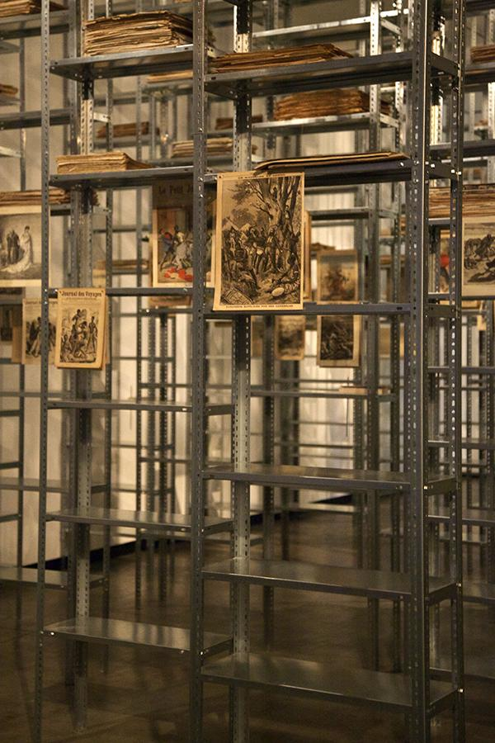
Embodiment and Affect
Kader Attia
The Culture of Fear: An Invention of Evil #1, 2013
Kader Attia, The Culture of Fear: An Invention of Evil #1, 2013
http://kaderattia.de/salon-der-angst-kunsthalle-wien-vienna-2/

Slide 3
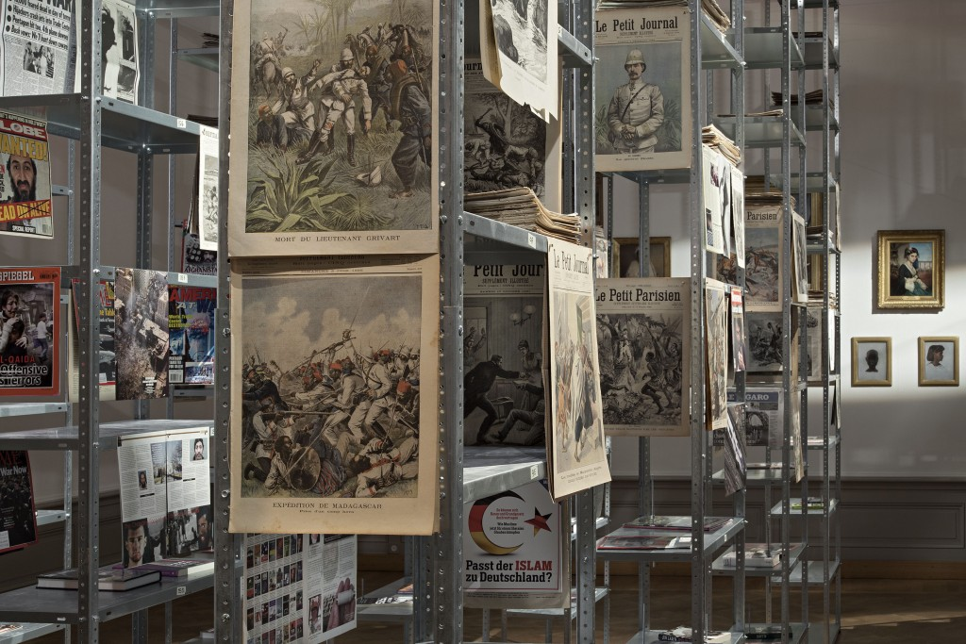

Slide 4
Vincent Brown
“With movement, interaction, and transformation, patterns are made and remade. By tracing these patterns, historical analysts can develop a visual language that may recover and illustrate spatial practices and processes. This is a thematic historical cartography, seen less as a technoscientific form of observation than as a rhetorical practice that can define, clarify, and advocate visions of the world that might otherwise go unarticulated.”
“Mapping a Slave Revolt” Social Text 33, no. 4 (2015), 136

Slide 5
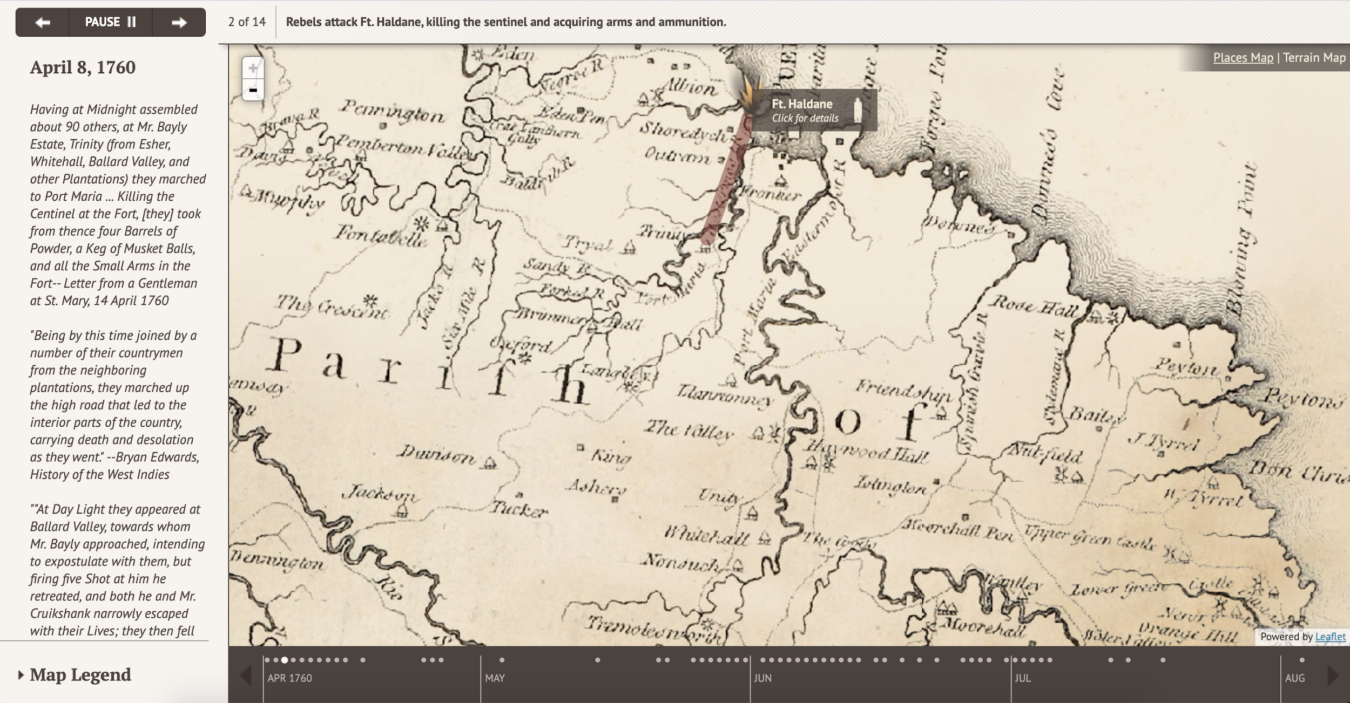

Slide 6
How can digital representation of the Journal des voyages surface “what might otherwise go unarticulated”?

Slide 7
Surfacing the unarticulated
Geographical coverage across time (What are readers taught to imagine?)
Distribution and gaps in geography
Relationships between entities
place/place
place/person or org
Entity-type analysis (discourse about people? where?)
Geography of images (Where are they located? Can they be located?)
Cartographical representation in the Journal - What does it reflect?

Slide 8
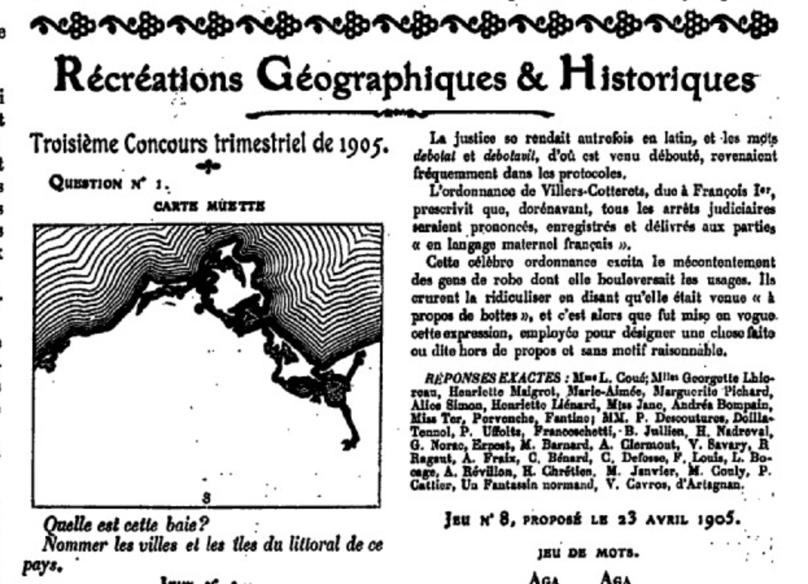
https://gallica.bnf.fr/ark:/12148/bpt6k104586v/f20.item

Slide 9
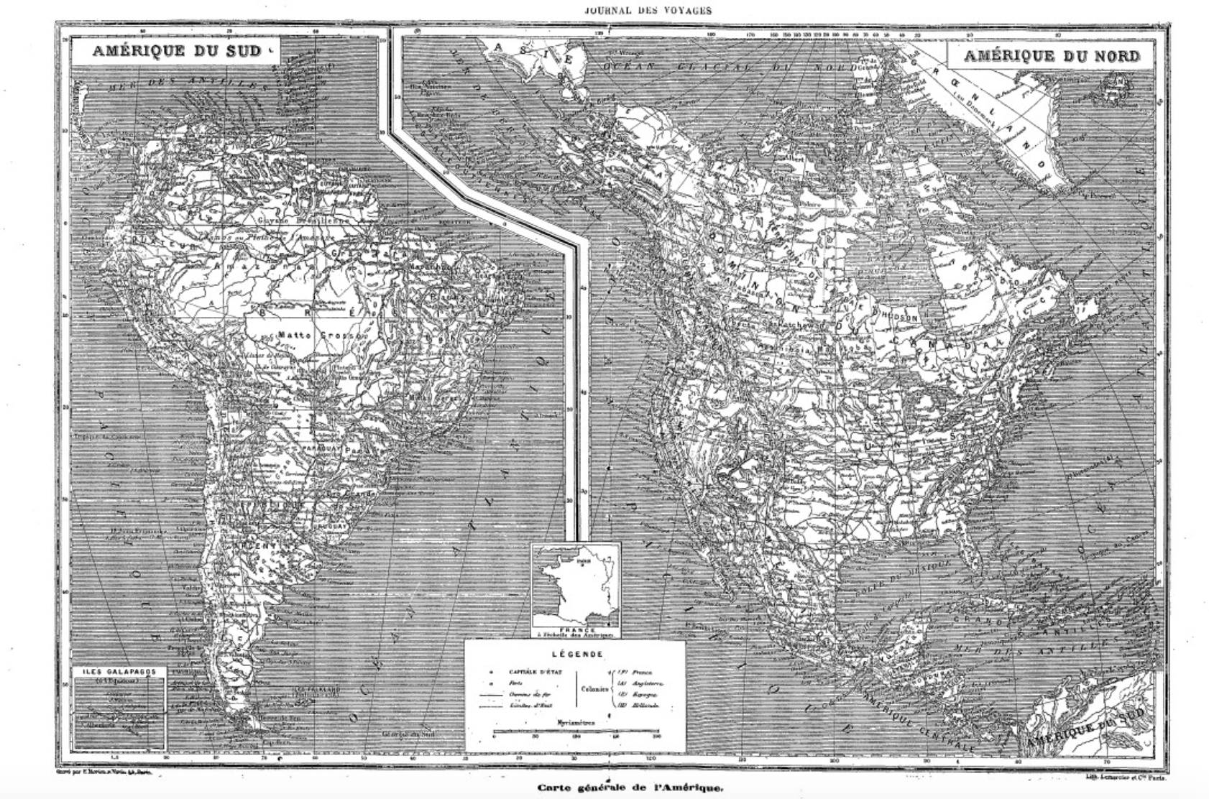
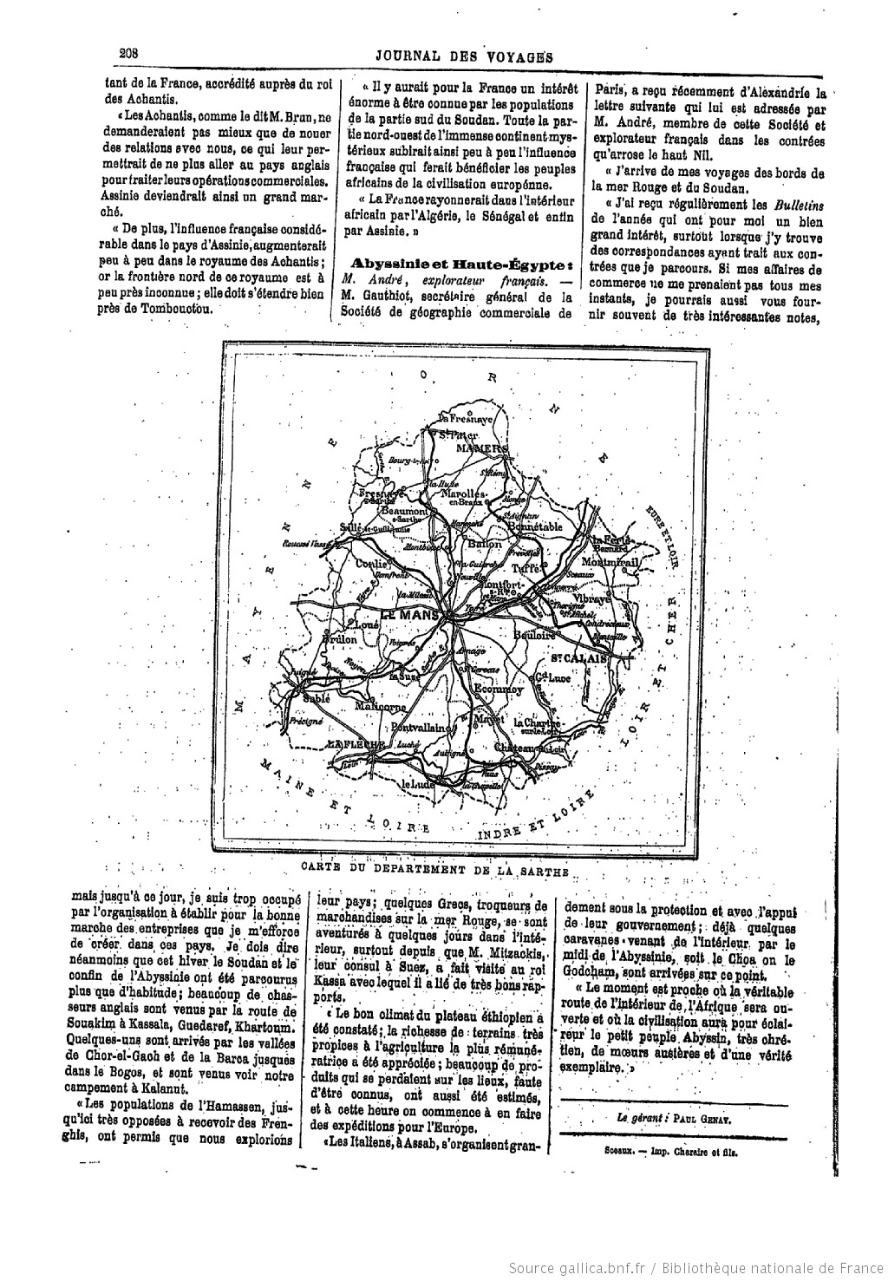
https://gallica.bnf.fr/ark:/12148/bpt6k104559z
https://gallica.bnf.fr/ark:/12148/bpt6k39869x/f289.item

Slide 10
2. Elizabeth Maddock Dillon
“we should not simply turn to the colonial archive to excavate the hidden documents of the past but should do so to understand how the production, circulation, and housing of documents themselves are part and parcel of a colonial technology of rule, part and parcel of how colonialism thinks and constructs the world… To redesign the archive—to imagine new forms with which to engage the archive—is thus to disrupt and throw into relief the coloniality of knowledge and history itself.”
“By Design: Remapping the Colonial Archive,” Social Text 33, no. 4 (2015), 144-145

Slide 11
How is the imagined geography of the Journal a reflection of technologies of rule?
Is it possible to uncover counter-geographies?

Slide 12
Technologies of & resistance to colonialism
How does the geography of the Journal map onto modern geo-political entities? What is the relationship between then/now?
What are the places not in the Journal?
What is “colonial” in the Journal?
Is this a periodical about the empire? If not, what does representation of the empire mean on its pages?)
How does the Journal establish its authoritativeness? Does the changing geographical scope over time illuminate this?

Slide 13
3. Jessica Marie Johnson
“The digital, like any tool, institution, or system across society, from law and medicine to the academy, will be radical or transformative only to the extent that researchers, programmers, designers, hackers, and users make an effort to dismantle the residue of commodification that is slavery’s legacy in the New World…”
“Markup Bodies: Black [Life] Studies and Slavery [Death] Studies at the Digital Crossroads,” Social Text 36, no. 4 (December 2018)
Notes:
“Doing truly embodied and data-rich histories of slavery requires similarly remixing conceptual, discursive, and archival geographies, with deliberate, pained intimacy, and, likely, some violence. But black digital practice challenges slavery scholars and digital humanists to feel this pain and infuse their work with a methodology and praxis that centers the descendants of the enslaved, grapples with the uncomfortable, messy, and unquantifiable, and in doing so, refuses disposability.”

Slide 14
How can spatial representation de-legitimize colonial violence and offer a history of the present?

Slide 15
Digital Spatial Challenges
Discrete data? Points, lines, and polygons
Continuous data?
Motion and relationships (QSR)
Base maps
Gazetteer source material
Projection
Symbology
Absence
Context
Some inspiration:
Corpus Synodalium https://corpus-synodalium.com/
Palestine Open Maps https://palopenmaps.org/view
LitLong https://litlong.org/welcome
Slave Revolt in Jamaica http://revolt.axismaps.com/
HGIS de las Indias https://www.hgis-indias.net/
Philologic https://github.com/ARTFL-Project/PhiloLogic4

Slide 16
A note on points and polygons
Points
What do they represent? Who decided? Gazetteers limit your automatic mapping abilities.
Ex: Our early GUI for viewing NER results and creating gold standard
Polygons
The risk of anachronism and overdetermined borders.
Luca Scholz, “Deceptive Contiguity: The Polygon in Spatial History,” Cartographica 54, no. 3 (Fall 2019), 206-216
Ex: Corpus Synodalium & FBTEE vs. webmapping

Slide 17
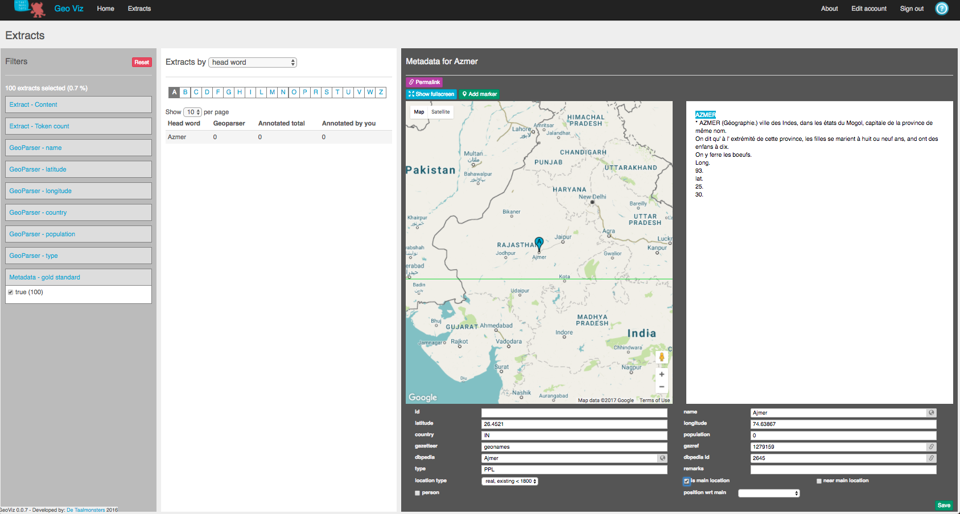

Slide 18
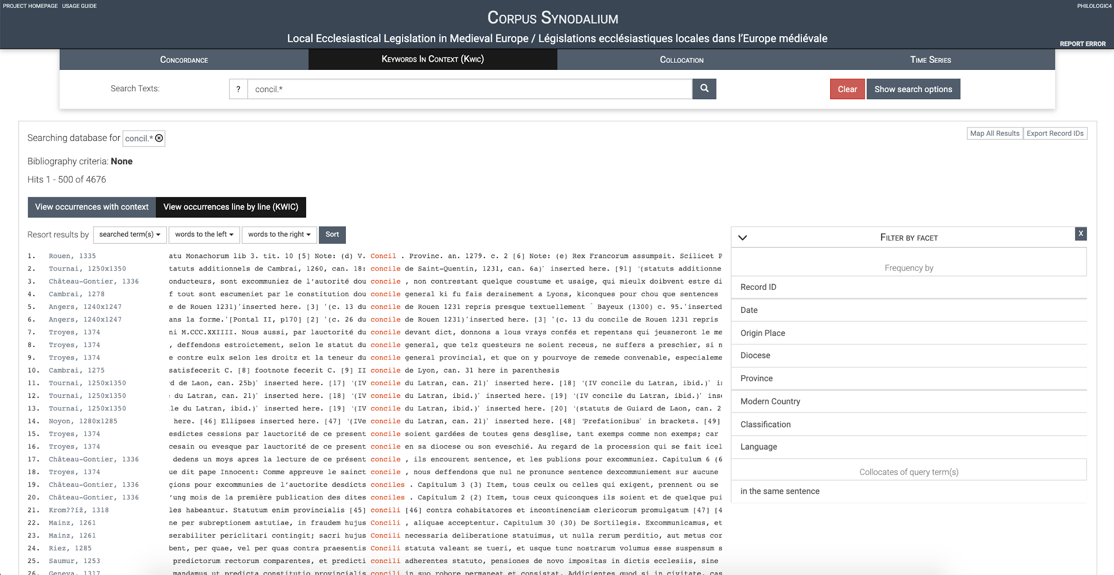

Slide 19
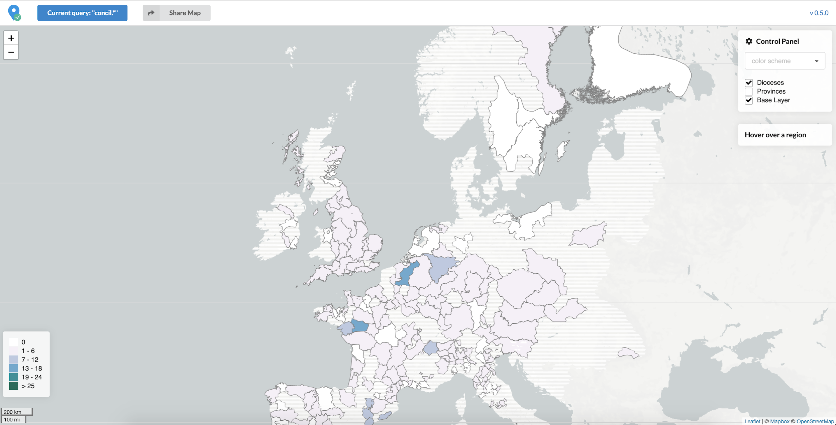

Slide 20
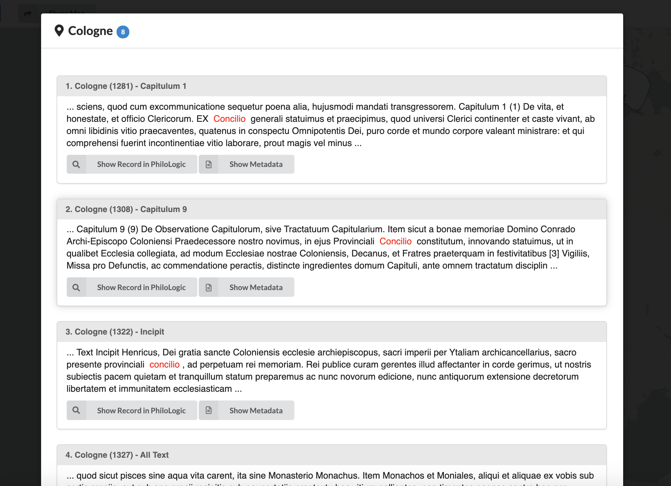

Slide 21
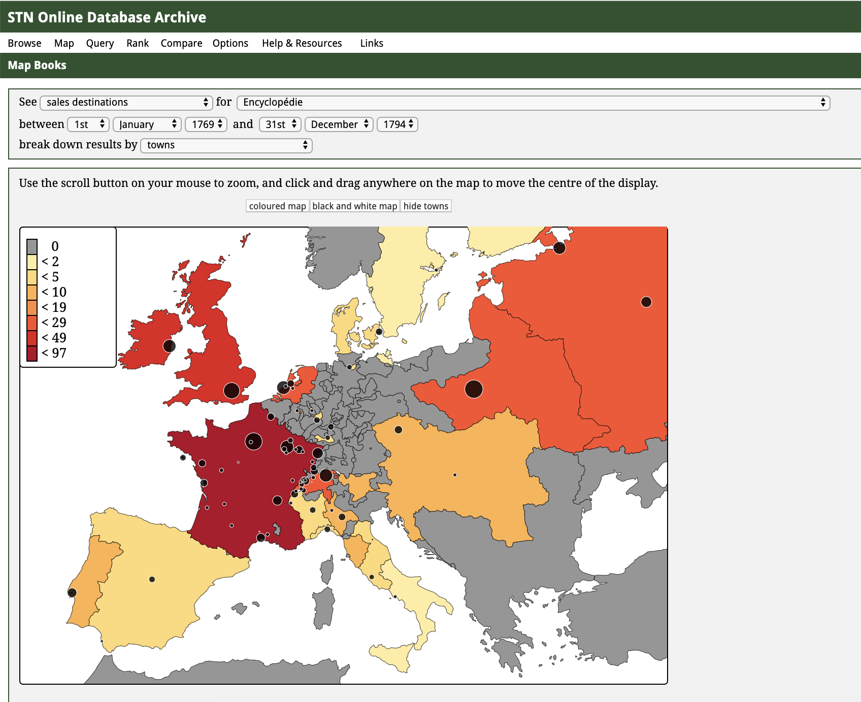

Slide 22
But… do you need a map?

Slide 23
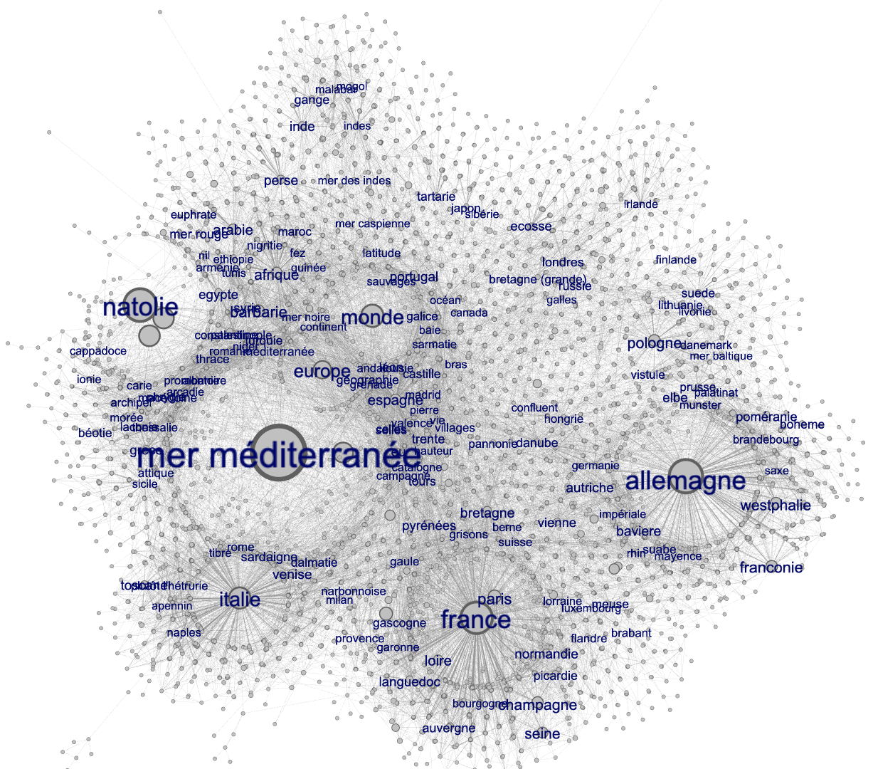

Slide 24
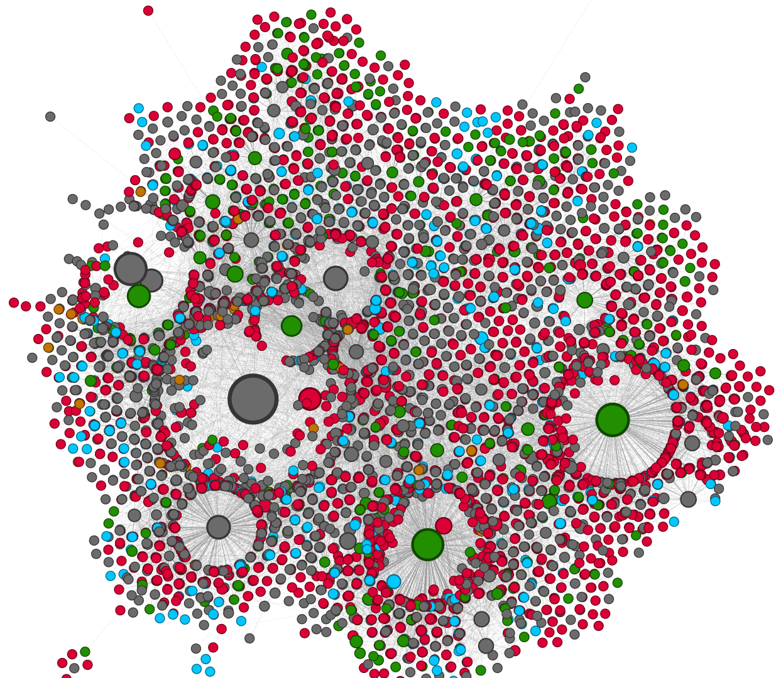
Color = geo class (city, country, region, ocean, river, etc.)

Slide 25
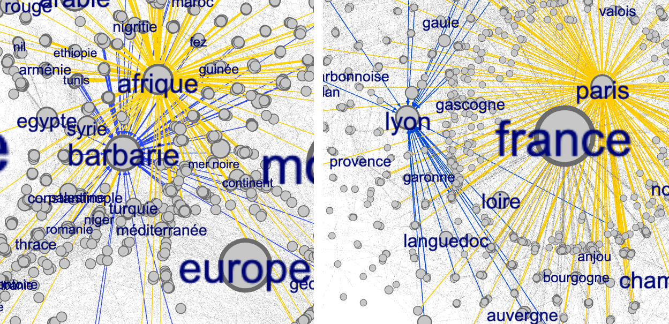

Slide 26
GUI vs. malleable visualizations (notebook outputs)

